Slide 1

UNIVERSITY OF DAR ES SALAAM
COLLEGE OF INFORMATION AND COMMUNICATION TECHNOLOGY
DEPARTMENT OF COMPUTER SCIENCE
IS 024
Abdallah, Rohit - 2021-01-00071

Slide 2
Daily Reminder App

Slide 3
Has a list of reminders that you need to know

Slide 4
The Development

Slide 5
Tools
React Native
Expo CLI
Expo Go (Used as an emulator)
Figma
VS Code

Slide 6
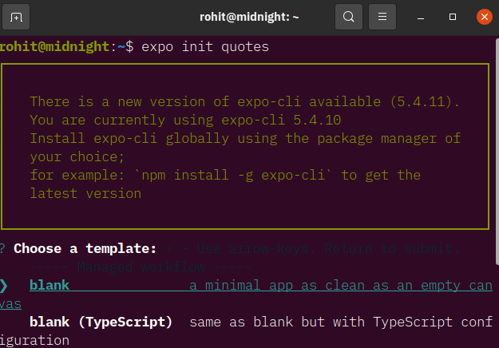
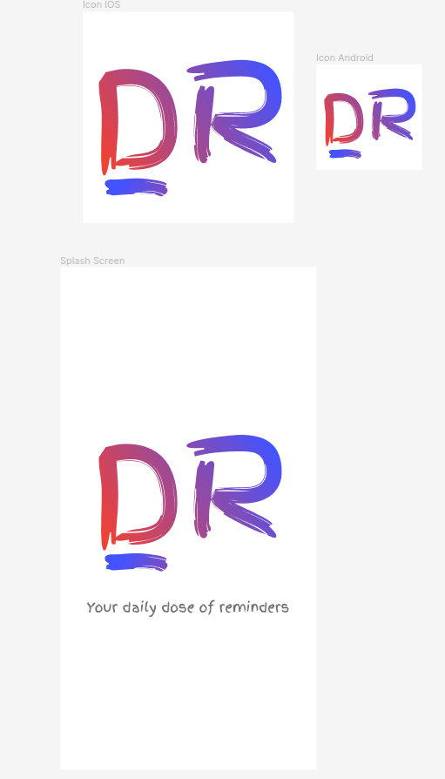
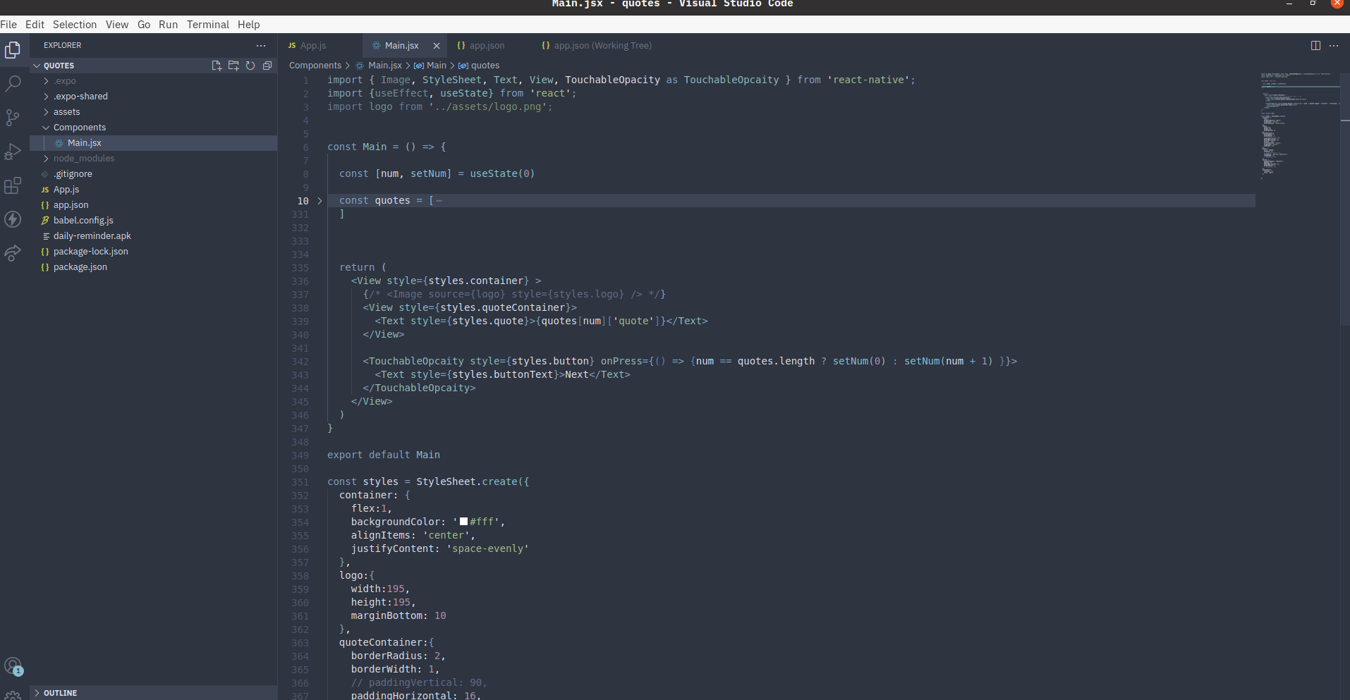
Procedure
Project was started with Expo CLI
The app was designed in Figma
It was coded in VS code
Tested with Expo GO mobile app

Slide 7
Results

Slide 8
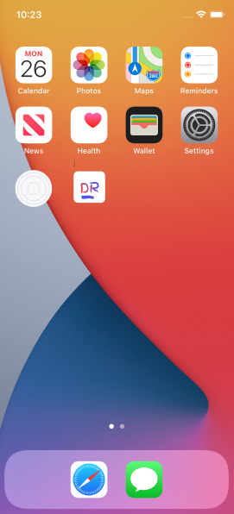

App Icon
App Loading Screen (Splash Screen)

Slide 9
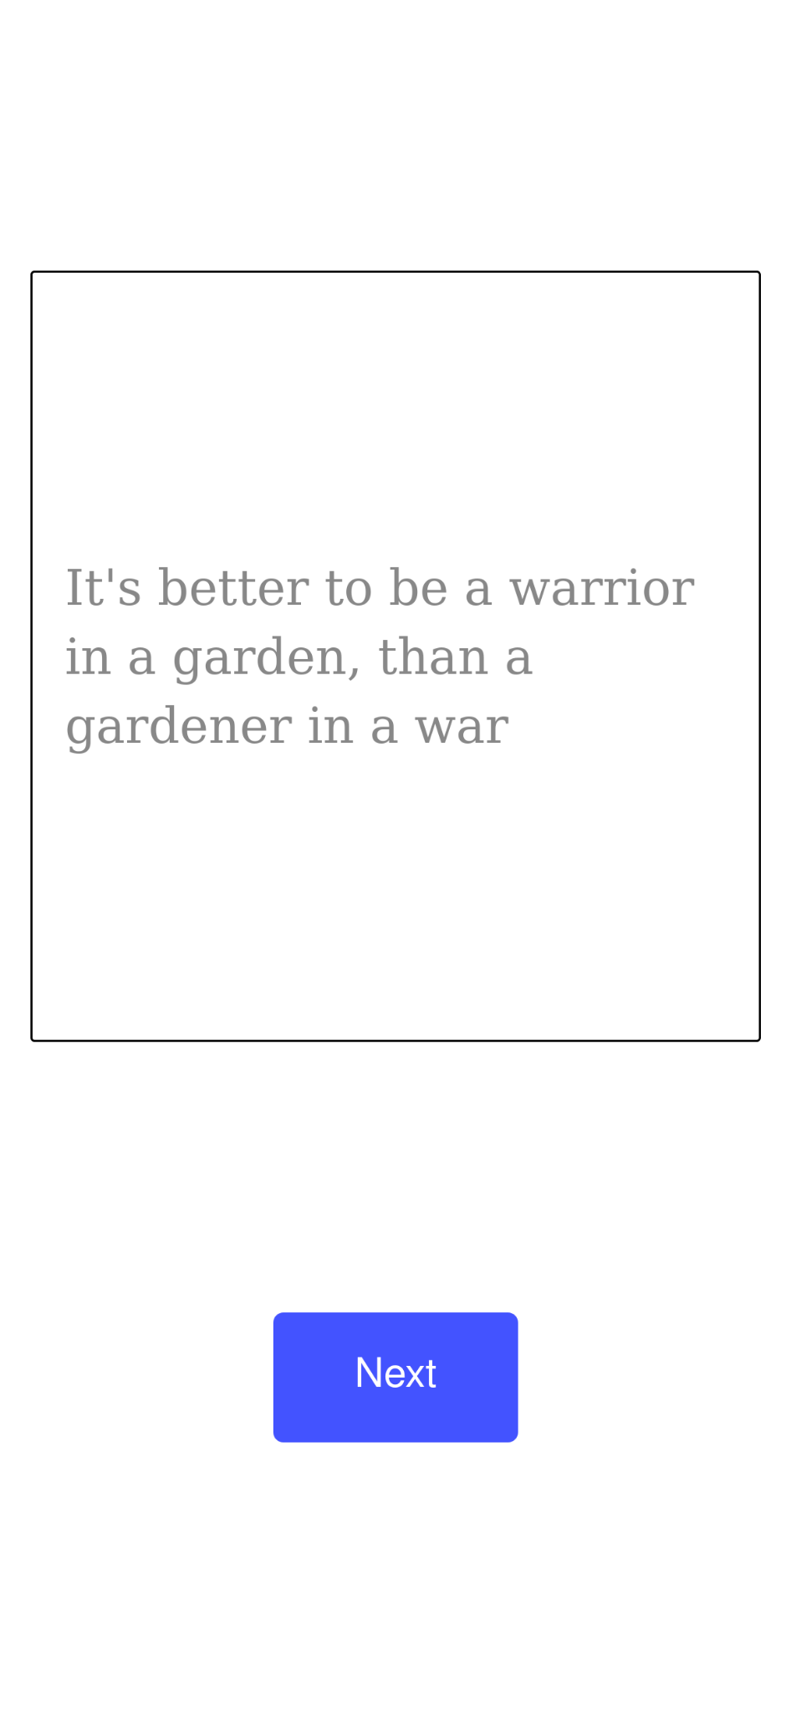
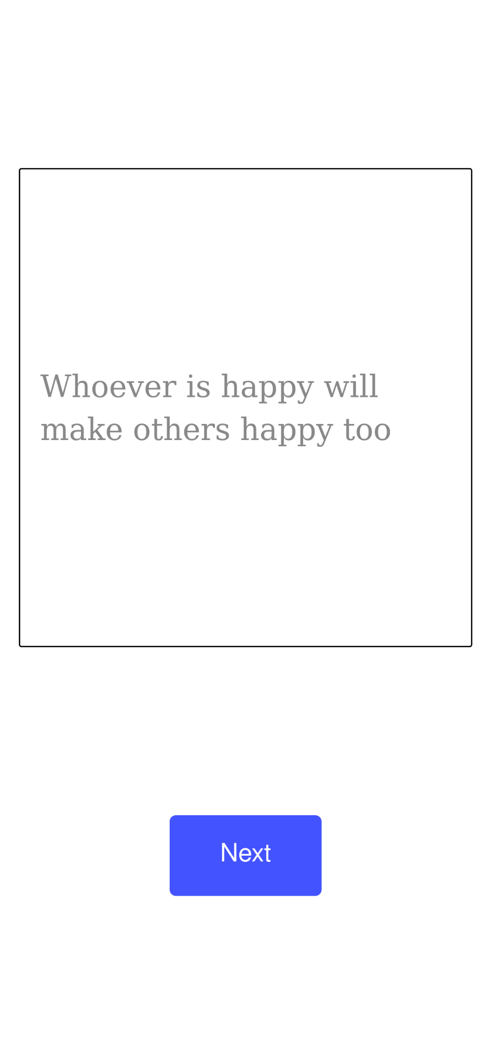
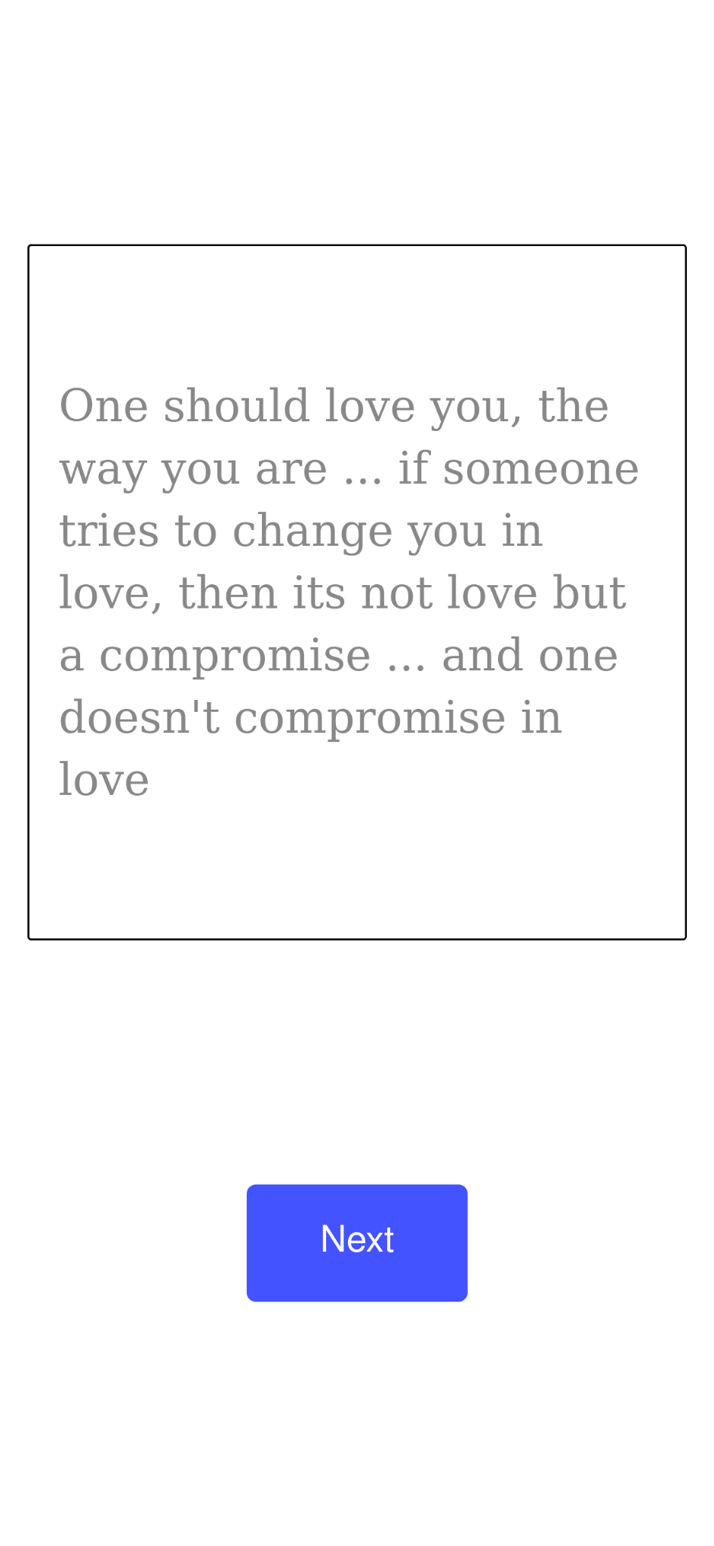
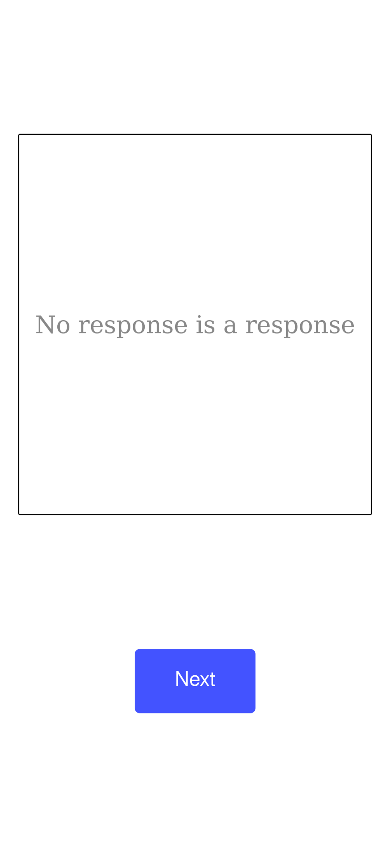

Slide 10
Conclusion

